Slide 1


Analyzing Regional Job Trends
Across Industry Sectors in the United States

Slide 2

The Team
A09
Prudhvi
Madhumitha
Leonardo
Sulaiman
Ethan
Jasmine

Slide 3

Introduction
In the United States, where career opportunities are as diverse as the nation itself, the path to meaningful employment is an intricate puzzle shaped by a multitude of factors.
The project, "Analyzing Regional Job Trends Across Industry Sectors in the United States," ventures into the dynamic world of employment to unveil the secrets that drive our nation's workforce.
By drawing upon authoritative data sources, such as the United States Census Bureau and the Bureau of Economic Analysis, this research is poised to illuminate the American job market.
Motivation
As graduate students who are looking forward to employment in the US, analyzing sector-specific opportunities, job trends and state-level economic patterns will help us make informed career choices, ensuring we put our best foot forward.

Slide 4


Data Sources
Business Dynamic Statistics from United States Census Bureau
GDP data across the States from Bureau of Economic Analysis
Meaning of NAICS Code - Sectors
Number of firms
Number of establishments
Number of employees
Number of net jobs created from expanding/contracting and opening/closing establishments
Number of employees associated with firm deaths
GDP
Per Capita Income
Geo Name - States
Years
Merged!

Slide 5
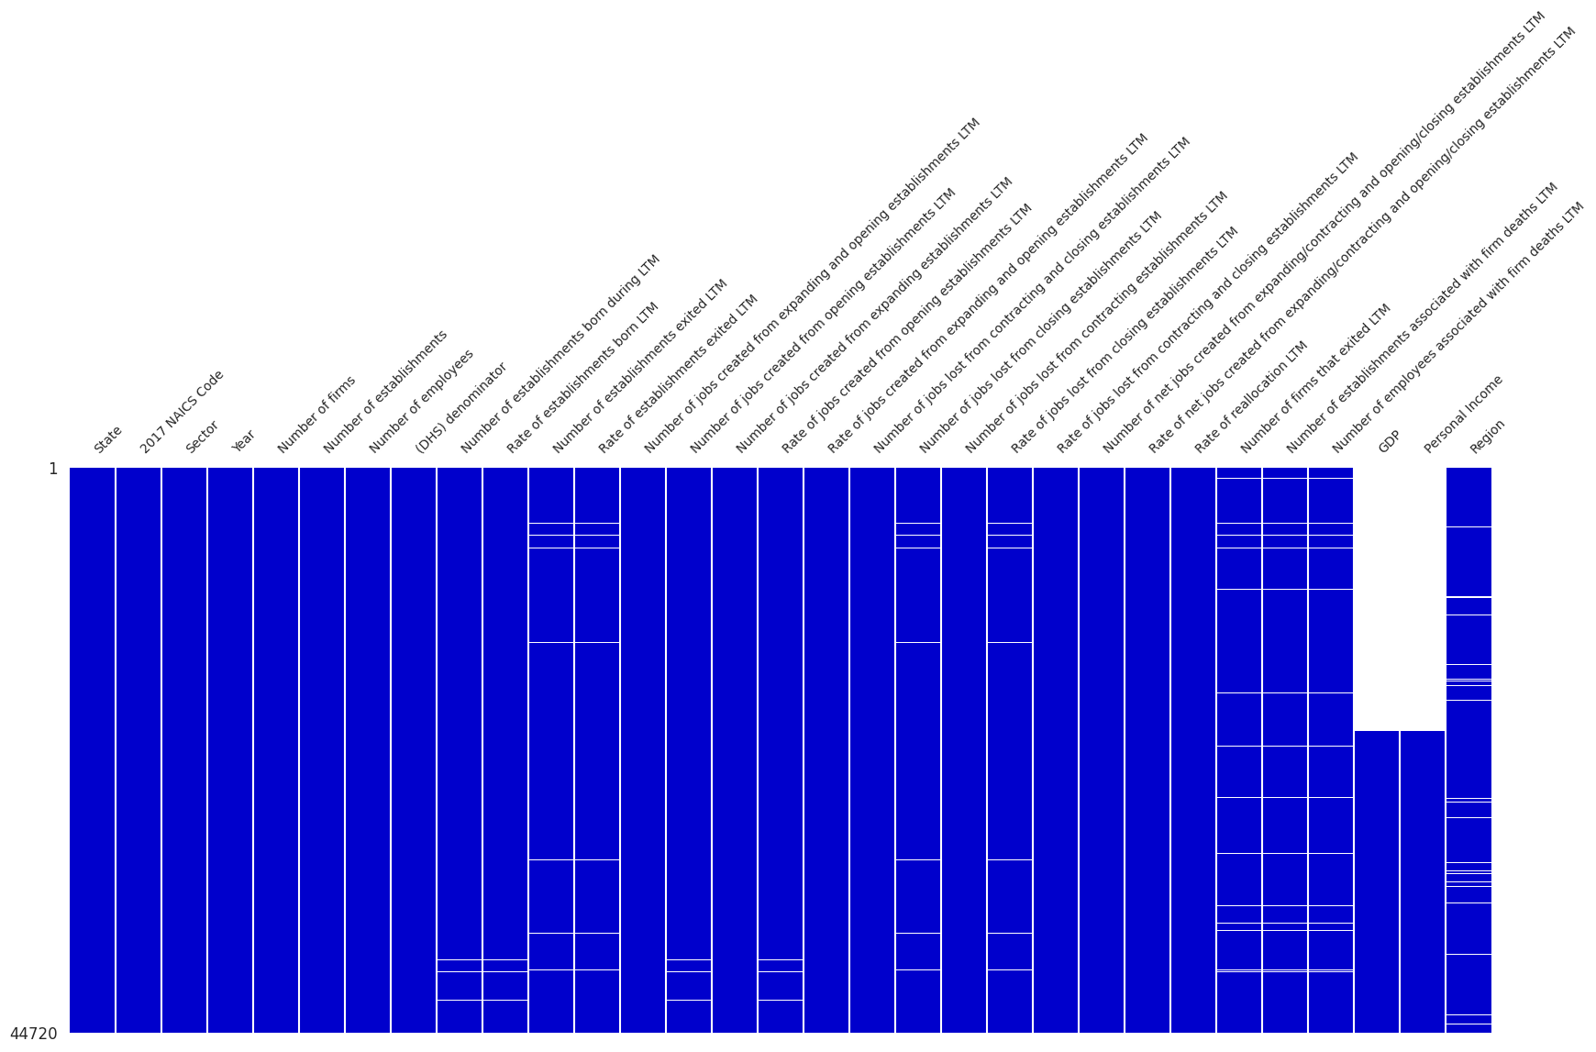
Data Preparation
Please forgive our long column names from raw data
The visualization unveils that the GDP and Personal Income columns are notably plagued by null values.
This observation stems from the fact that while the current dataset captures data up to 2020, the Business Dynamic Dataset commences from 1978.
Consequently, our analytical journey, leveraging the merged dataset, commences from the year 2000.

Slide 6

Enough of Cleaning and Prepping

Slide 7
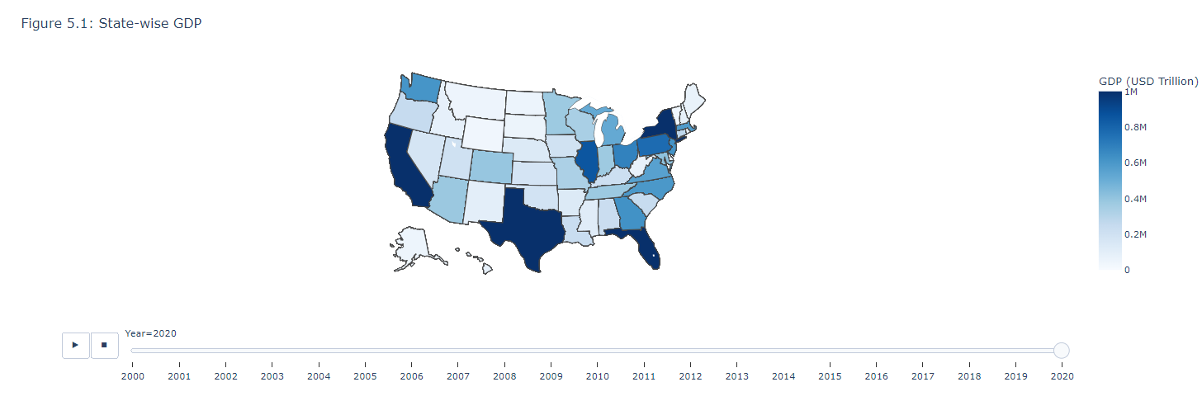
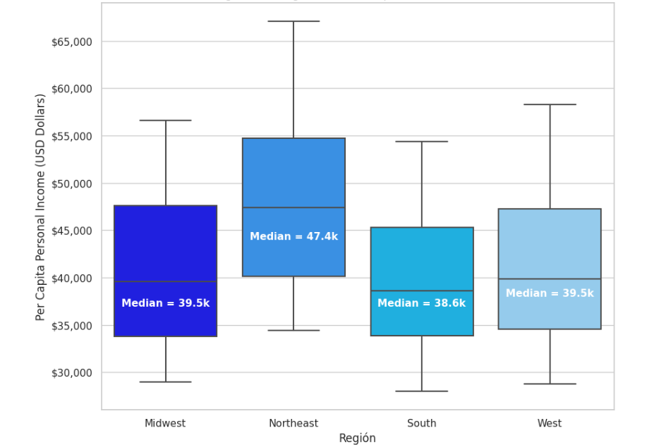
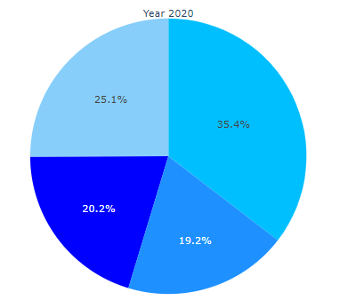
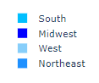
State-wise GDP (2020)
Region-wise Per Capita Personal Income
Firms Distribution Across Regions
Data Exploration

Slide 8
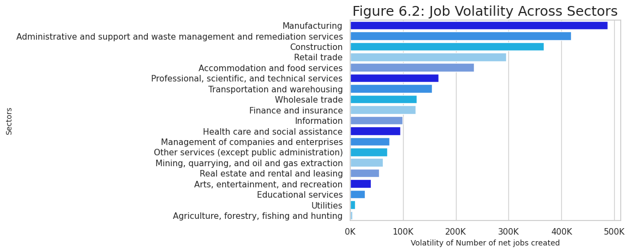
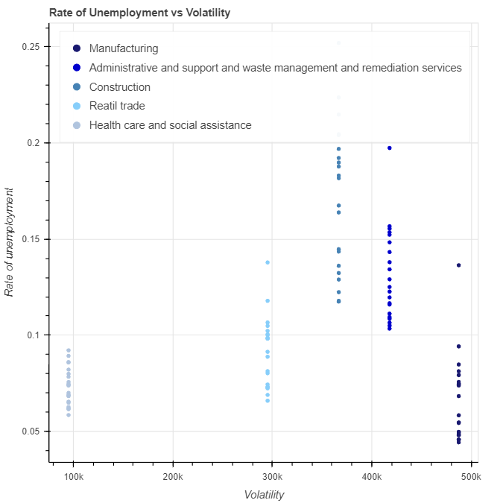
Identifying the Sectors with highest and lowest Employment Volatility
Reasons :
Capital Constraints
Decreased Consumer and Business Spending
Global Economic Factors

Slide 9
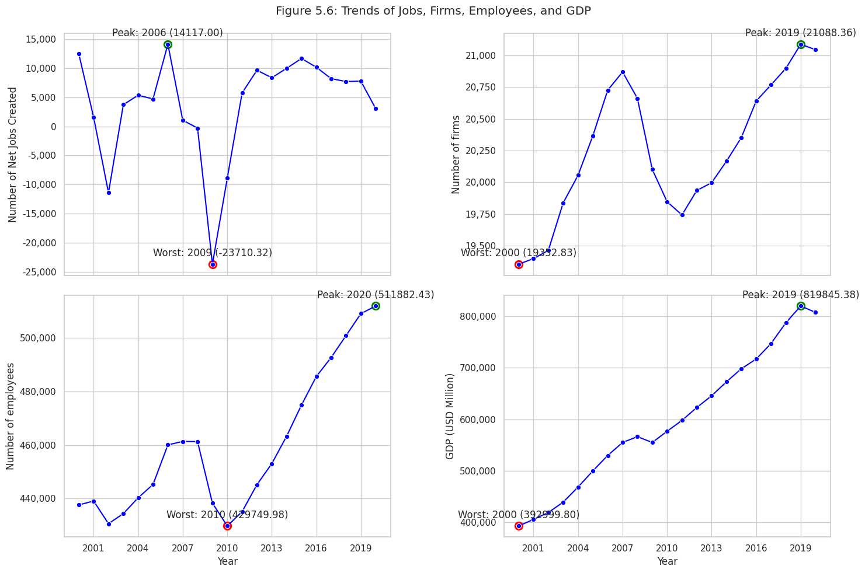
Studying the effect of Economic Events on Jobs across Sectors - Part I

Slide 10
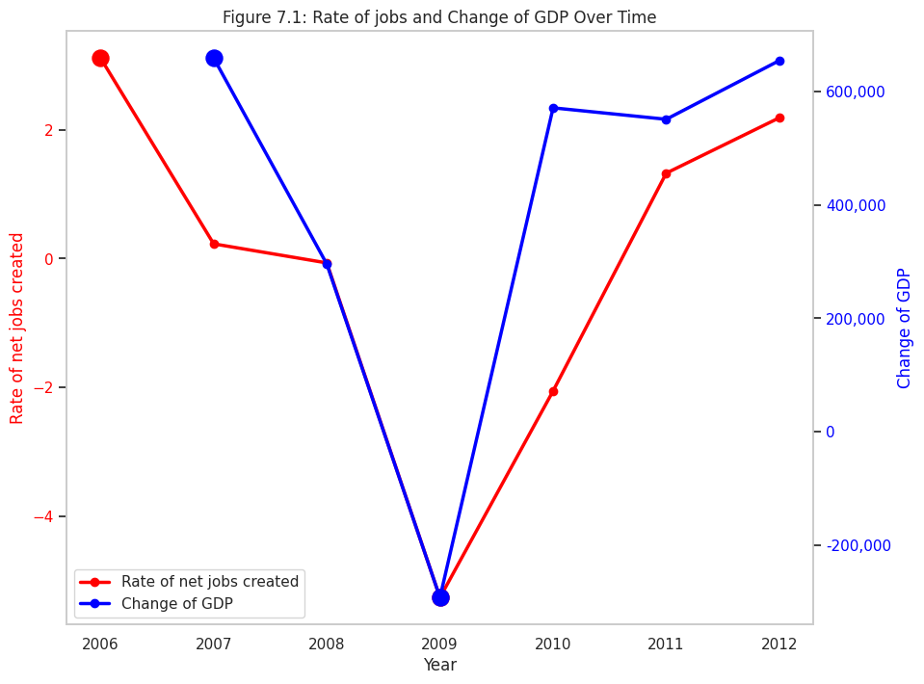
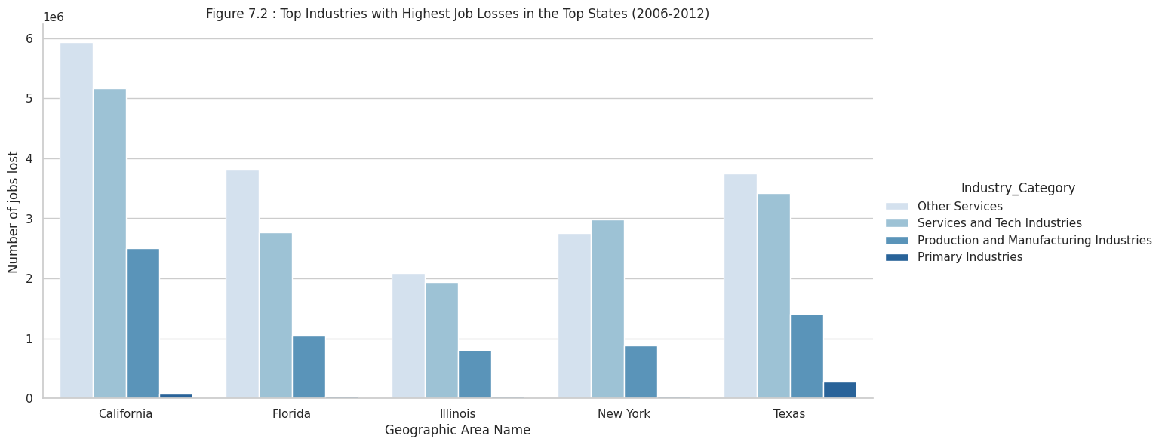
Studying the effect of Economic Events on Jobs across Sectors - Part II
Top industries that bore the brunt of job losses in the US.
Focus on the states that suffered the most significant job losses, notably California, Texas, Florida, New York, and Illinois.
Notably, the industries of Retail trade, Administrative, Professional services, Accommodation and Food Services, and Construction emerged as the top job loss sectors.
High correlation between the rate of jobs created and changes in GDP over the years 2006 to 2012.
Stark dip in both job creation and GDP changes attributing severe economic recession that had a profound impact on the United States.

Slide 11
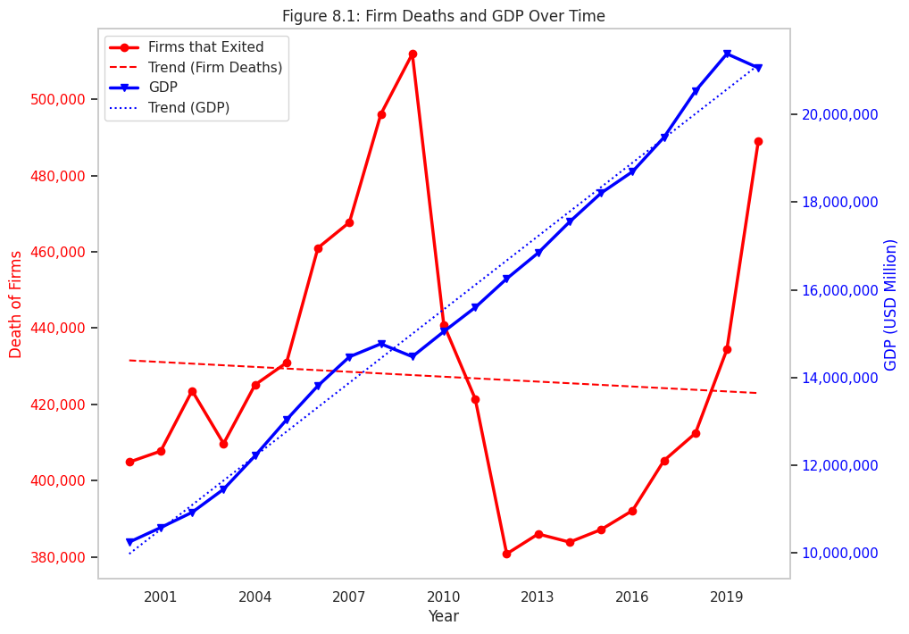
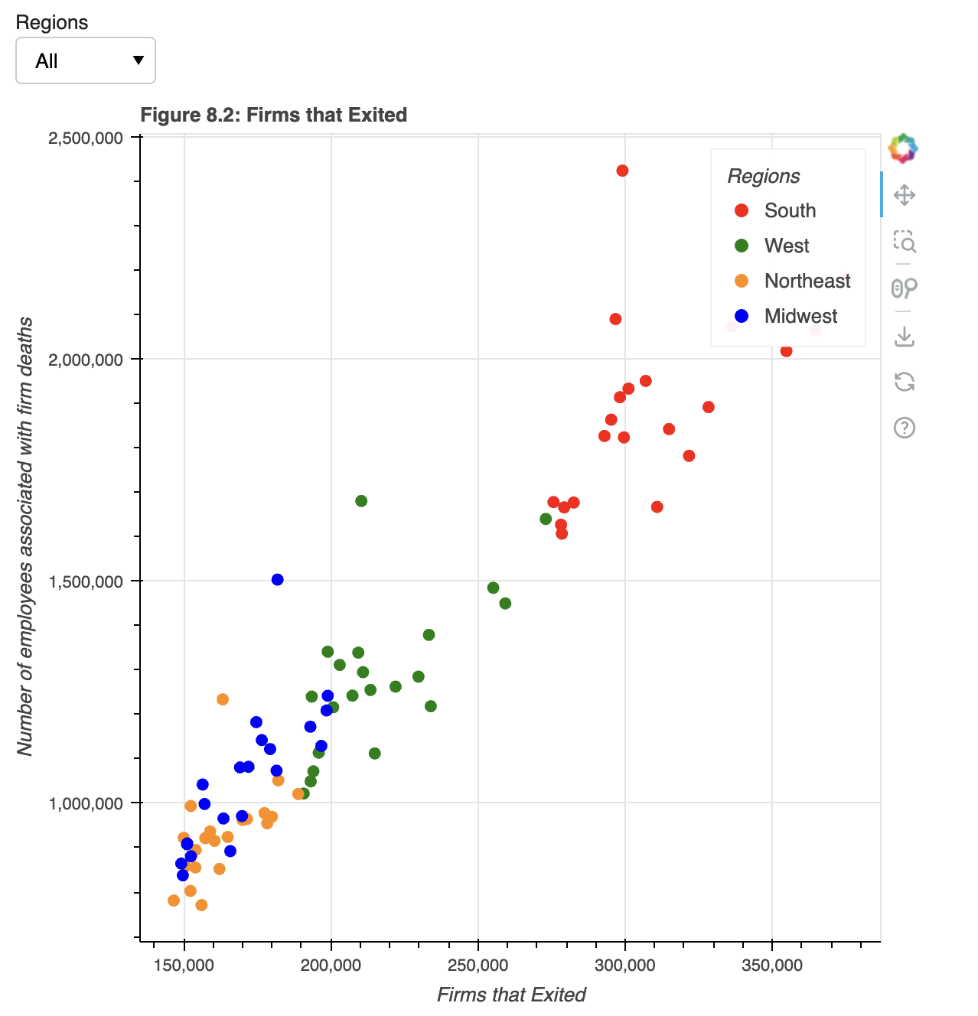
Effect of Firm Deaths - GDP and Employees
Employee Layoffs
The South region has experienced the most substantial impact in terms of business closures and employee layoffs, while the Midwest and Northeast regions have maintained stability with fewer closures and less impact on employment.
Firm Deaths and GDP
In 2009 and 2020, peak firm closures (511,916) aligned with a ~4.3% GDP dip, revealing the tight link between economic health and business challenges.

Slide 12
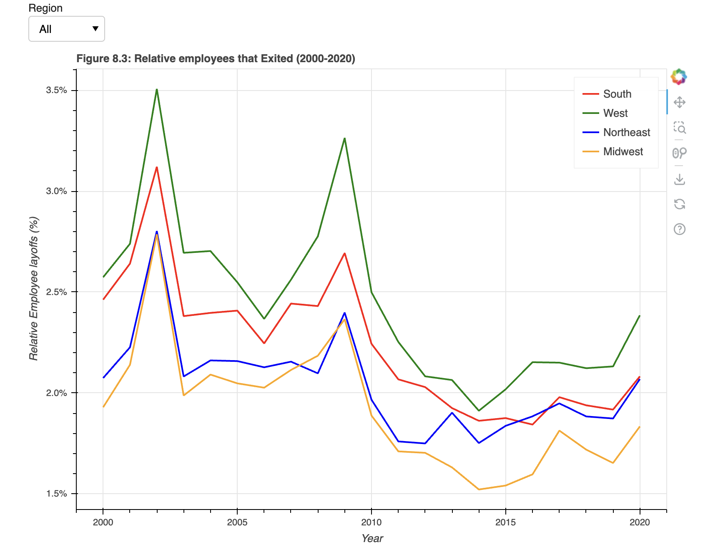
Relative Employee Layoffs Across Regions
The West faced the highest layoffs (3.5% in 2002, 3.3% in 2009), while the Northeast and Midwest remained stable. Insights reveal regional disparities, urging targeted interventions.
This is because even though South had more absolute number of layoffs, West was worst hit relatively.

Slide 13

That’s OK, But……

Slide 14



A Deep Dive into the US Economy (2000-2020) - Takeaways
2008 Crisis
California, Texas, Florida, New York, and Illinois experienced the most pronounced setbacks. Collectively, these states have witnessed a staggering ~9 million job losses because of the crisis
Sectors
Manufacturing, Administration Services, and Construction, were sectors that showed significant changes in the number of jobs over time
Employees layoffs and firms closures:
The West region surfaces as the most vulnerable, with a significant 20% decrease in jobs. In stark contrast, the Midwest remains an epitome of stability, experiencing a mere 3% decrease

Slide 15

Ok Ok, I get it But…….

Slide 16
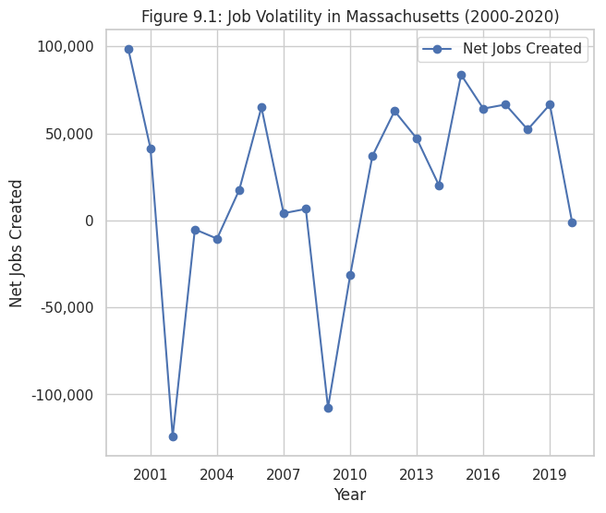
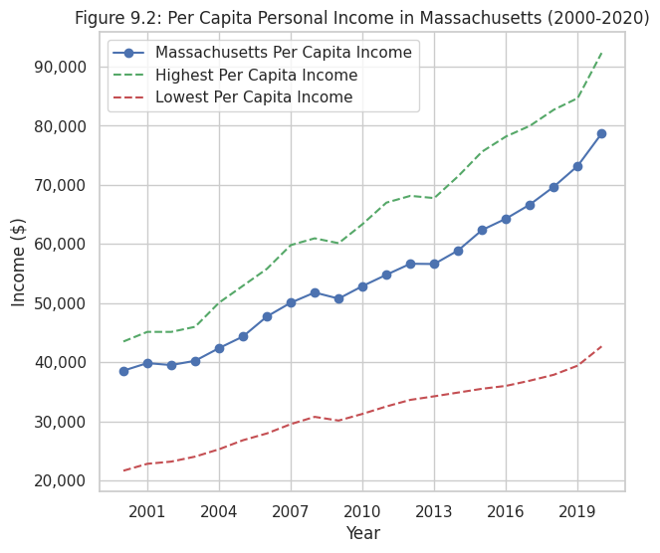
Massachusetts : Job Volatility and Per Capita Income
2. Connecticut
3. Massachusetts
4. New Jersey
Income Rank
33. Nevada
34. Massachusetts
35. Tennessee
Job Volatility Rank

Slide 17

Massachusetts is expensive, but you can make more money by working here too!
Thank you for bearing with us!

Slide 18
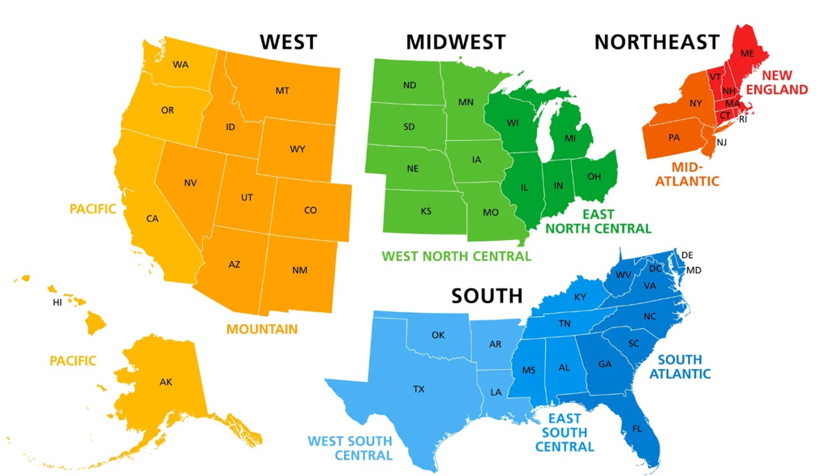
Distribution of States by Region

